Slide 1

Influence Of Popular Trends in Social Communities
CS522 Social Computing
Department of Computer Science and Engineering
Indian Institute of Technology, Ropar
Course Instructor:
Dr. Sudarshan Iyengar
:Associate Professor
Department of Computer Science & Engineering
Presented By:
Anurag Jaiswal (2021CSM1002)
Shourya Gupta (2021CSM1007)
Arunava Chaudhuri (2021CSM1020)

Slide 2
Contents
Introduction
Problem Statement
Basic Model
Method
Experiment
Result
Conclusion
Future Work
References

Slide 3
Introduction
Online news media: Reliable and widely accessed source.
Newspaper headlines: Insights happening in social platforms
Popular trends or news: Effect on social community .
Popular trends: Can divide people?
Interest of people: change with popular trends?

Slide 4
Problem Statement
Diffusion of trending topic in social network.
Change of Interest of a person over time.
How it spreads through influential person?
Can have the ability to create communities?
Evolution of a trend over a duration.

Slide 5
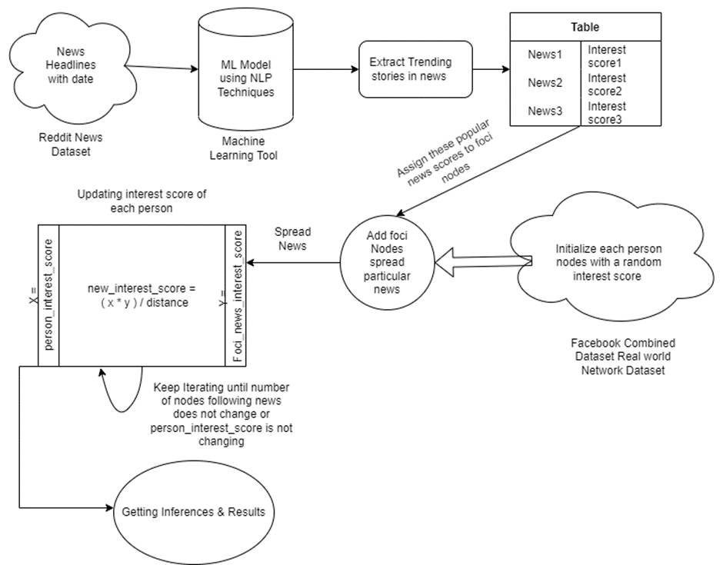
Basic Model
Fig: Flowchart Model

Slide 6
Method
Extraction of Trending Topics from News Headlines
Preprocessing and Keyword Extraction.
Keyword Scoring
Filtering and Post Processing
News Clustering and Keywords Vectorization
Topic Clustering using News Similarity

Slide 7
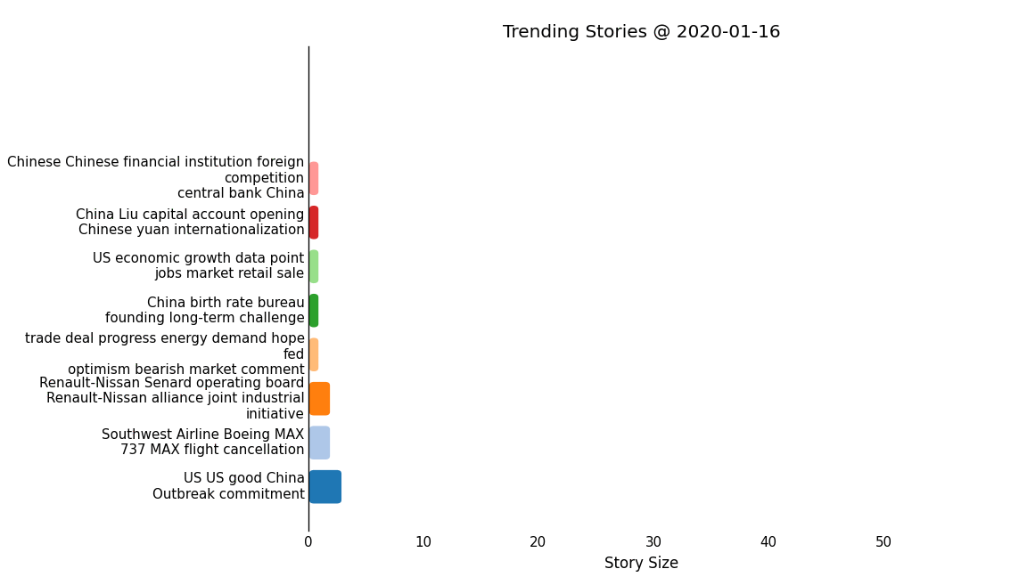
A Visualization About trending Topics Over a Duration

Slide 8
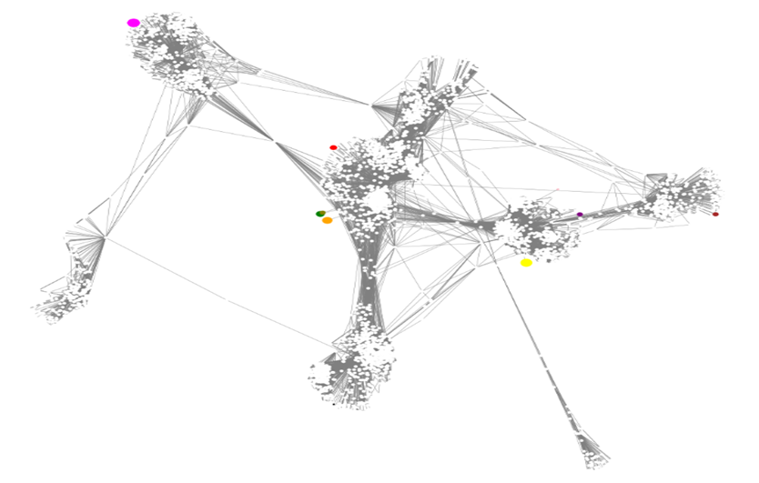
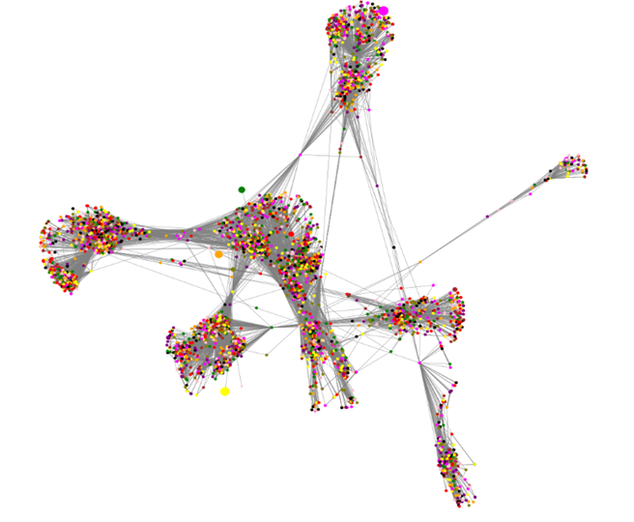
Method (Contd.):
Extraction of top k (= 10) news with their score values
Apply those news to foci nodes of the network.
Initialized the random interest scores for each node
Colored the Node with is highest interest score.

Slide 9
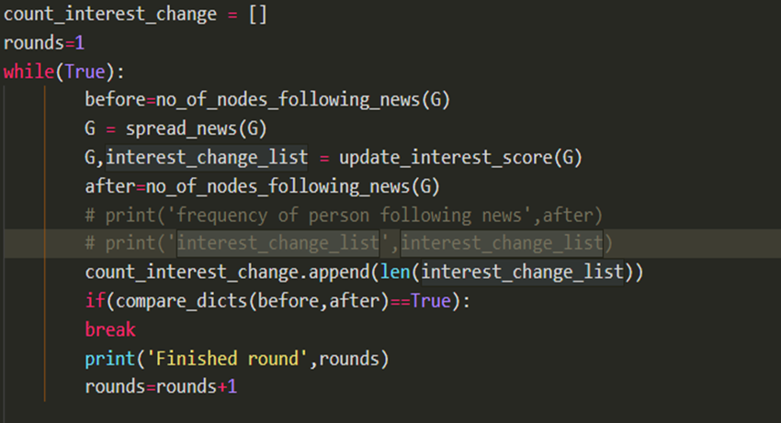
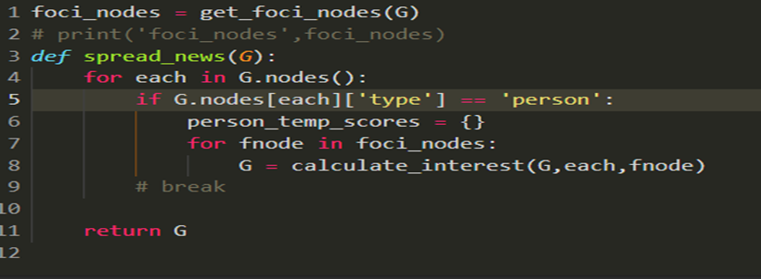
Experiment:
Keep iterating and evaluating until the Interest scores of each node are not changing.
Call spread news function.
Calculate interest score for each person node with respect to each foci node.

Slide 10
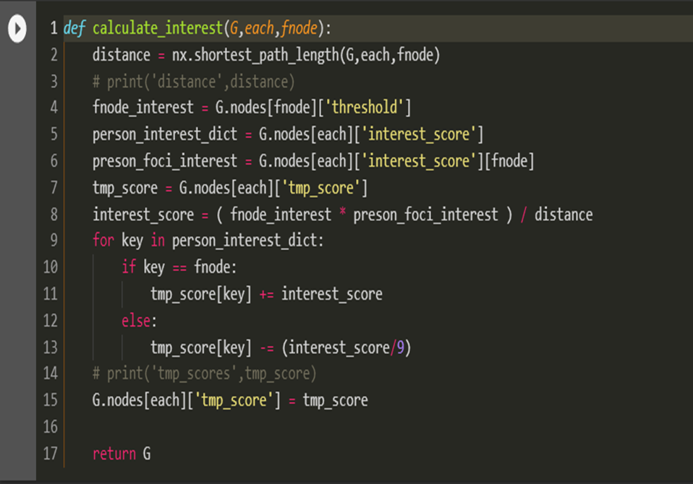
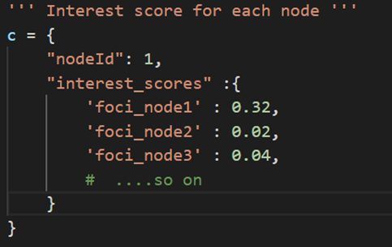
Experiment (Contd.):
Calculate Interest Score: Three parameters are used
X = foci_node_interest_score & Y = person_node_interest_score
Distance = shortest path length from foci node
New Interest Score = ( X * Y ) / distance
Add new interest score to person node for that particular fnode.
Subtract ( interest score / k ) for other fnodes

Slide 11
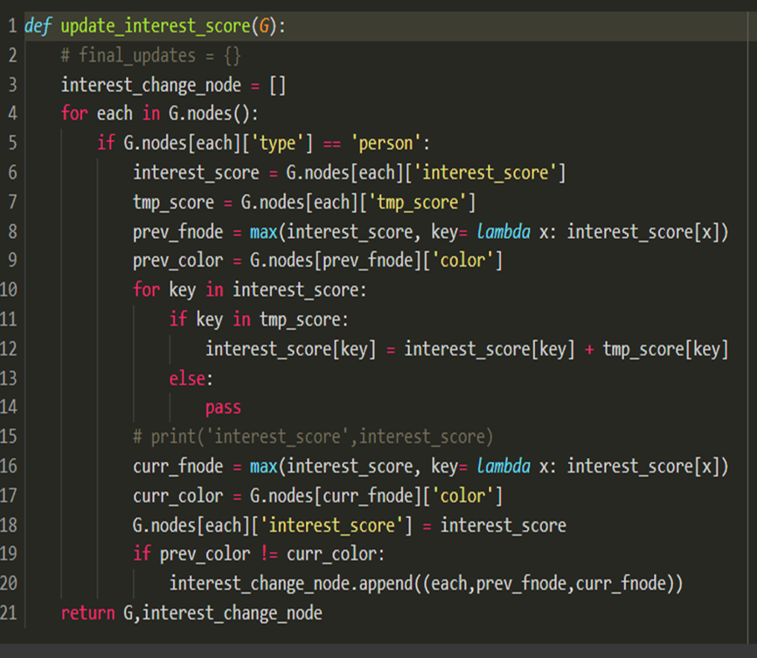
Experiment (Contd.):
Updating interest scores
Evaluating the final interest scores of each nodes
Update the global interest list.
Above step is repeated until interest score stop changing

Slide 12
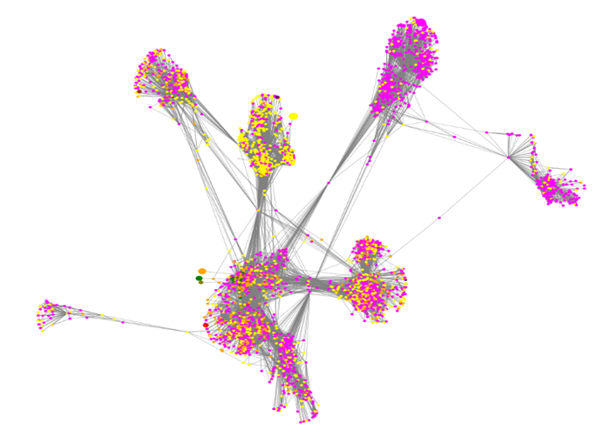
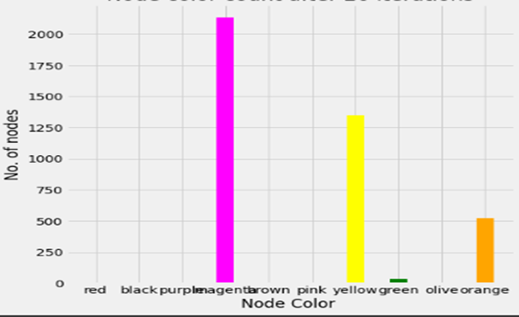
Result:
After convergence of interest score we assign the color of max value of interest score to that particular node.

Slide 13
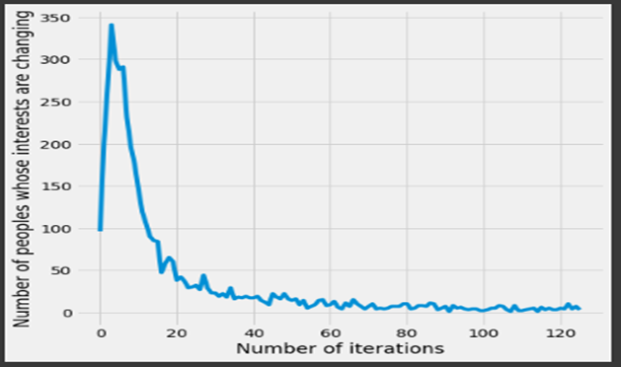
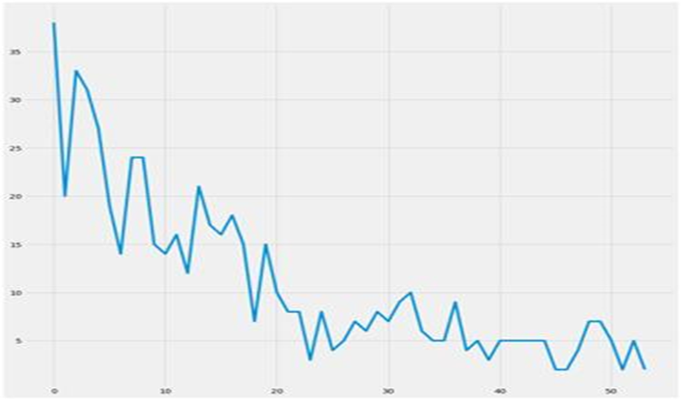
Result (Contd.):
Plot the number of nodes whose interest score are changing during a number of iteration.

Slide 14
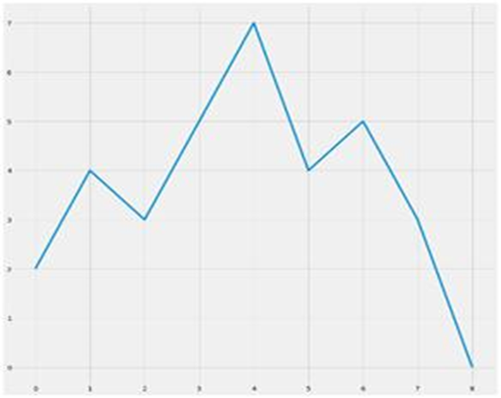
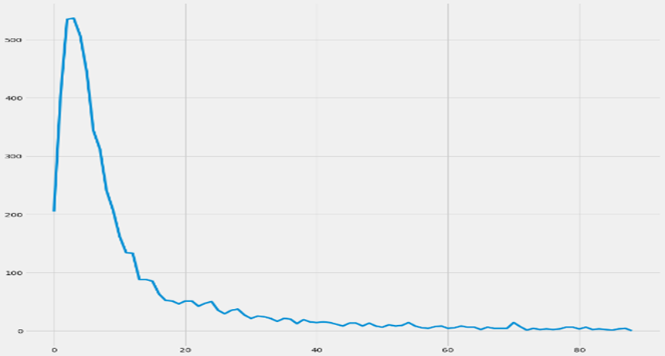
Plots on random graphs:

Slide 15
Conclusion:
News communities graph has converged .
Some news are accepted by large no of peoples and
Some news are accepted by very small no of people and
Some news is not accepted by anyone .
Simulation is nearly resembling real world scenario.

Slide 16
Future Work:
Further study on how fake news spread by linking fake news to some near neighbors of the influential people .
Pump fake news by increasing its score abruptly and then observe the effect.
Random score can be replaced by real time interests and
their dependencies with other interest can be analyzed and
random score can be generated really by considering interests location and other factors

Slide 17
References:
Social Media Content Headlines and Their Impact on Attracting Attention by Kishokanth Jeganathan & Andrzej Szymkowiak
Detection of Trending Topic Communities: Bridging Content Creators and Distributors by Lorena Recalde, David F. Nettleton, & Ludovico Boratto
Identifying communities by influence dynamics in social networks by Angel Stanoev, Daniel Smilkov & Ljupco Kocarev
From calls to communities: a model for time varying social networks by Guillaume Laurent, Jari Saram¨aki & M´arton Karsai

Slide 18
Thank You

